Slide 1
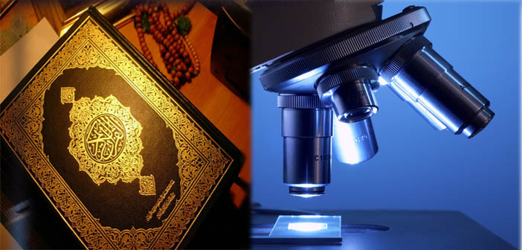

Slide 2

Quran & Science
By: FAIZA FATIMA
BSMD-1ST SEMESTER

Slide 3
Islam, A Complete Religion!
Allah the All-Mighty Says: "This day have I perfected your religion for you and completed My favor upon you and have chosen for you Islam as your religion.” [Surah Al-Maidah Ayat 5:3]

Slide 4
Why Allah Has Selected Islam As The Best Religion?
The perfect way of life:
{We verily sent Our messengers with clear proofs and revealed with them the scripture and the balance [i.e. the authority to establish justice], that mankind may observe justice and the right measure… (Surah Al Hadid ) [verse57:25)
Peace And Comfort:
"Allah intends for you ease, and does not want to make things difficult for you" [2:185]; and "Allah does not want to place you in difficulty" (Surah Al Baqarah) [verse5:6]
The problem to every solution is with Islam. Whether it is some political aspect, economic aspect or social aspect:
For example:
“”The seller and the buyer have the right to keep or return goods as long as they have not parted or till they par; and if both the parties spoke the truth and described the defects and qualities (of the goods), then they would be blessed in their transaction, and if they told lies or hid something, then the blessings of their transaction would be lost.” (surah Al Bukhari)
Zakat –eradicates poverty and protects the society from crimes and social class clashes. (Surah Tauba)[verse 9:71]
Hudud – discourage man to commit crimes [Al-Maidah 5:38].
Wasiat – distribution of wealth to heirs after death with fairness.

Slide 5
Kindness towards All:
“…..Treat with kindness your parents and kindred, and orphans and those in need; speak fair to the people; be steadfast in prayer; and give Zakaah.” (Surah Al Baqarah, verse 2:83)
Avoiding fighting and crimes:
“When two Muslims fight (meet) each other with their swords, both the murderer as well as the murdered will go to Hell-fire.” It was said: “O Allah’s Messenger! It is all right for the murderer but what about the murdered? Allah’s Messenger replied: “He surely had the intentions to kill his companion.” (Surah Al-Bukhari,vol 2 hadith 30)

Slide 6
Quran, A Complete Guidebook!
“Every instrument provides a book of instruction which tells how to operate it. For human beings, Quran serves as a book of instruction as to how to live a successful life”

Slide 7
Quran is also a live “MIRACLE”
Nobody has ever able to create any kind of change in this Holy Book.
Quran knows EVERYTHING!
History of mankind
A deep sea of wisdom & knowledge

Slide 8
Why today’s SCIENCE has progressed so much?

Slide 9
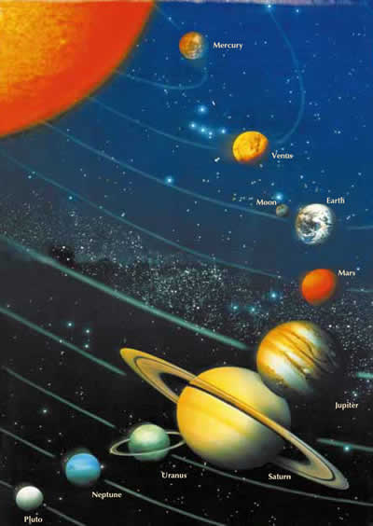
Discoveries & Exploration in Science Through Quran
HOW??
Orbits:
While referring to the Sun and the Moon in the Qur'an, it is emphasized that each moves in a definite orbit.
"It is He Who created the night and the day, and the sun and the moon. They swim along, each in an orbit. " (Surah Al-Anbiya, 21:33)
However, the entire universe is full of paths and orbits such as this one, is written in the Qur'an as follows:
"By the sky full of paths and orbits." (Surah Dhaariyaat, 51:7)

Slide 10
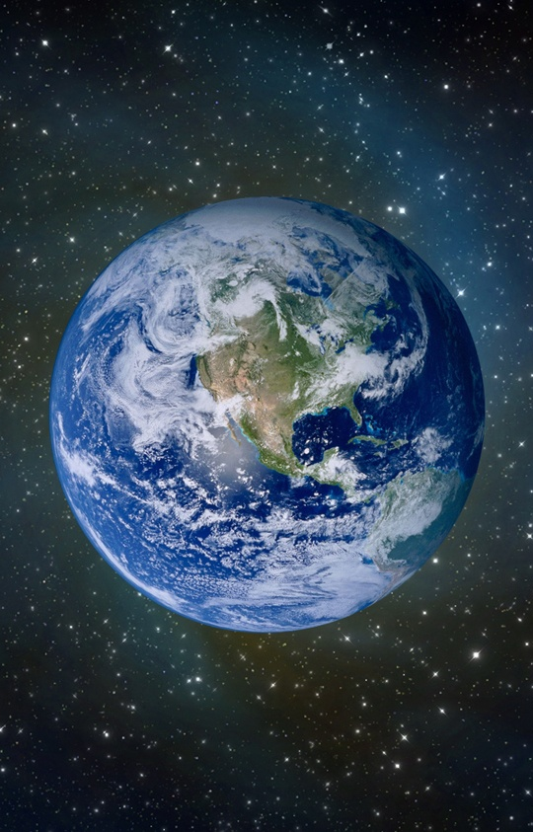
The Roundness of the Earth:
He has created the Heavens and the Earth for Truth. He wraps the night up in the day, and wraps the day up in the night." (Surah az-Zumar, 39:5)
The information given in the verse about the day and the night wrapping each other up includes accurate information about the shape of the world. This can be true only if the earth is round. Since the Qur'an is God's word, the most correct words were used in it when it comes to describing the universe.

Slide 11
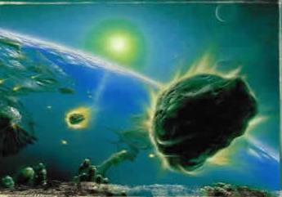
The Protected Roof:
In the Qur'an, God calls our attention to a very interesting attribute of the sky:
"We made the sky a preserved and protected roof yet still they turn away from Our Signs.." (Surah Al Anbiya, 21:32)
This attribute of the sky has been proved by scientific research.
And if the protected roof is not there than, it causes the destruction and harmfulness to a human being.

Slide 12
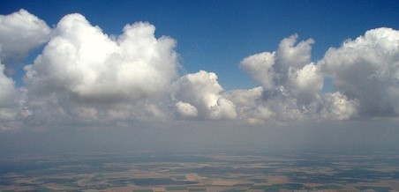
The Returning Sky: In the Qur'an, there is the "returning" function of the sky.
"By Heaven with its cyclical systems." (Surah Tarik, 86:11)
This word interpreted as "cyclical" in Qur'an translations also has meanings of "sending back" or "returning".
As known, the atmosphere surrounding the Earth consists of many layers. Each layer serves an important purpose for the benefit of life. Research has revealed that these layers have the function of turning the materials or rays they are exposed to back into space or back down to the Earth.

Slide 13
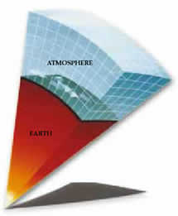
The Layers of the Atmosphere:
One fact about the universe revealed in the verses of the Qur'an is that the sky is made up of seven layers.
"It is He Who created everything on the earth for you and then directed His attention up to heaven and arranged it into seven regular heavens. He has knowledge of all things." (Surah Al Baqarah, 2:29)
The Earth has all the attributes that are needed for life. One of them is the atmosphere, which serves as a shield protecting living things. Today, it is an established fact that the atmosphere is made up of different layers lying on top of one another. Just as it is described in the Qur'an, the atmosphere is made up of exactly seven layers. This is certainly one of the miracles of the Qur'an.

Slide 14
The Movement of Mountains: The Qur'an draws attention to a very important geological function of mountains.
In one verse, we are informed that mountains are not motionless as they seem, but are in constant motion.
"You will see the mountains you reckoned to be solid going past like clouds." (Surah Naml, 27:88)
This motion of the mountains is caused by the movement of the Earth's crust that they are located on. The Earth's crust 'floats' over the mantle layer, which is denser.

Slide 15
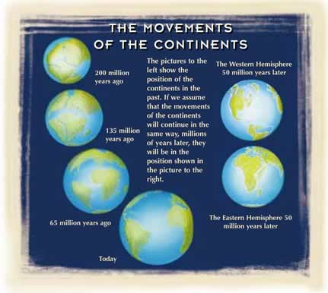

Slide 16
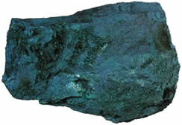
The Miracle in the Iron:
Iron is one of the elements highlighted in the Qur'an.
"…And We sent down iron in which there lies great force and which has many uses for mankind...." (Surah Hadid, 57:25)
All this shows that iron did not form on the Earth, and was "sent down to earth", in exactly the same way as stated in the verse: It is clear that this fact could not have been scientifically known in the 7th century, when the Qur'an was revealed.
Iron ingot

Slide 17
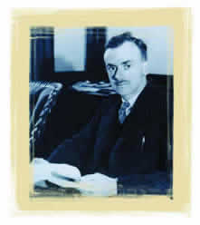
Concept of Pairs:
Glory be to Him Who created all the pairs: from what the earth produces and from themselves and from things unknown to them." (Surah Yasin, 37:36)
Although the concept of ''pair'' or "couple" commonly stands for male
and female. The British scientist Paul Dirac, who proposed that matter is created in pairs, was
awarded the Nobel Prize for physics in 1933. This discovery, called ''parité'', maintains that
matter is paired with its opposite: anti-matter. Anti-matter carries the opposite properties to
matter. This fact is stated in a scientific source in this way: "...every
particle has its antiparticle of opposite charge… …and the uncertainty relation tells us that pair
creation and pair annihilation happen in the vacuum at all times, in all places.
Paul Dirac

Slide 18
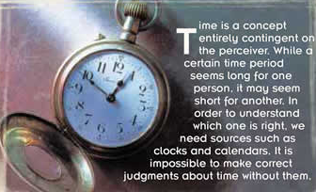
The Relativity of Time:
Today, the relativity of time is a proven scientific fact. This was revealed by Einstein's theory of relativity at the early years of the 20th century. Until then, people did not know that time was a relative concept, and that it could change according to the environment.
With one exception though; the Qur'an included information about time's being relative! Some verses about the subject read:
"He directs the whole affair from heaven to earth. Then it will again ascend to Him on a Day whose length is a thousand years by the way you measure." (Surah Sajdah, 32:5)

Slide 19

The Formation of Rain:
The formation of rain takes place in three stages. First, the "raw material" of rain rises up into the air with the wind. Later, clouds are formed, and finally raindrops appear.
The Qur'an's account of the formation of rain refers exactly to this process. In one verse, this formation is described in this way:
"It is God Who sends the winds which stir up clouds which He spreads about the sky however He wills. He forms them into dark clumps and you see the rain come pouring out from the middle of them. When He makes it fall on those of His slaves He wills, they rejoice" (Surah Ar-Rum, 30:48)

Slide 20
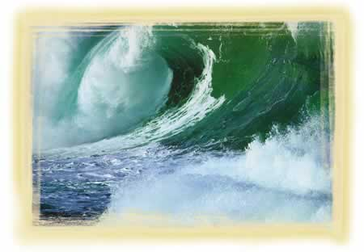
The Fecundating Winds:
In one verse of the Qur'an, the "fecundating" characteristic of the winds, and the formation of rain as a result are mentioned.
"And We send the fecundating winds, then cause water to descend from the sky, therewith providing you with water in abundance." (Surah Al Hijr, 15:22)
If winds did not possess this property, water droplets in the upper atmosphere would never form, and there would be no such thing as rain.

Slide 21
The Seas not mingling with one another:
One of the properties of seas that has only recently been discovered is related in a verse of the Qur'an as follows:
"He has let loose the two seas, converging together, with a barrier between them they do not break through." (Surah Ar Rahman, 55:19-20)
This property of the seas, that they come together yet do not mingle with one another at all, has only very recently been discovered by oceanographers. Because of the physical force called "surface tension", the waters of neighboring seas do not mix. Caused by the difference in the density of their waters, surface tension prevents them from mingling withone another, just as if a thin wall were between them.
The interesting side to this is that during a period when people had no knowledge of physics, surface tension, or oceanography; this was revealed in the Qur'an.

Slide 22
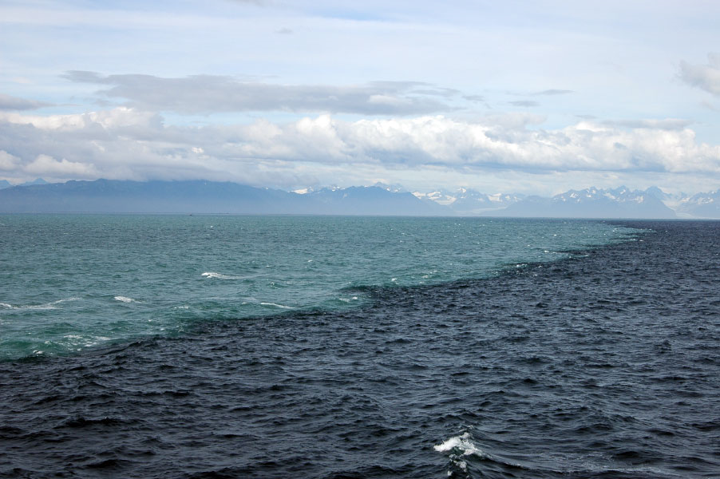

Slide 23
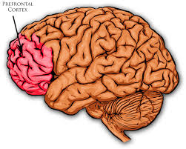
The Region that controls Our Movements:
No indeed! If he does not stop, We will grab him by the forelock, a lying, sinful forelock." (Surah Al-Alaq, 96:15-16)
Research carried out in recent years revealed that the prefrontal area, which is responsible for the management of particular functions. A book entitled Essentials of Anatomy and Physiology, which includes the results of the latest research on the functions of this area, says:
In relation to its involvement in motivation, the prefrontal area is also thought to be the functional center for aggression.
So, this area of the cerebrum is responsible for planning, motivation, and initiating good and sinful behavior, and is responsible for telling lies and the truth.
It is clear that the statement "the lying, sinful forelock" corresponds completely to the above explanations. This fact, which scientists have only discovered in the last 60 years, was stated by God in the Qur'an long years ago.

Slide 24
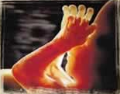

The Birth of a Human Being:
"It is We Who have created you. Why, then, do you not accept the truth? Have you ever considered that (seed) which you emit? Is it you who create it? Or are We the Creator?" (Surah Al Waqiyah, 56:57-59)
It clearly describes the reproduction cycle in the book of science, ,however the man's developmental stages as described in the Qur'an are in perfect way already.
Many stages of a baby's development in the mother's womb are related in the Qur'an. God describes this development with the verse:
"…(We then) formed the lump into bones and clothed the bones in flesh“ (Surah Muminun, verse 14)

Slide 25
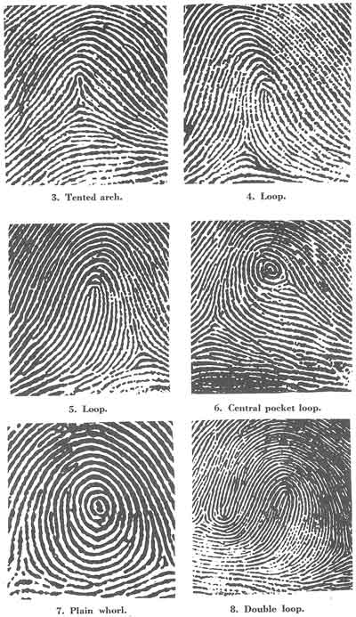
The Identity in the Fingerprints:
While it is stated in the Qur'an that it is easy for God to bring man back to life after death, peoples' fingerprints are particularly emphasized:
"Yes, We are able to put together in perfect order the very tips of his fingers." (Surah Al Qiyamah, 75:3-4)
The emphasis on fingerprints has a very special meaning. This is because everyone's fingerprint is unique to himself. Every person who is alive or who has ever lived in this world has a set of unique fingerprints.
That is why fingerprints are accepted as a very important proof of identity, exclusive to their owner, and are used for this purpose around the world.

Slide 26
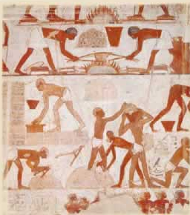
The word Haman In the Quran:
The information given in the Qur'an about ancient Egypt reveals many historical facts that had remained undisclosed until recent times.
Haman is a character whose name is mentioned in the Qur'an, along with the Pharaoh. He is recorded in six different places of the Qur'an as one of the closest men to the Pharaoh.
Haman was a person who lived in Egypt at the time of Moses, who had been close to the Pharaoh, and had been involved in construction work, just as imparted in the Qur'an.
"Pharaoh said, 'Council, I do not know of any other god for you apart from Me. Haman, kindle a fire for me over the clay and build me a lofty tower so that perhaps I may be able to climb up to Moses' god! I consider him a blatant liar.'" (Surah Al Qasas, 28:38).

Slide 27
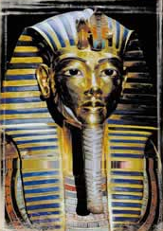
Titles of the Egyptian rulers in Quran:
It being encounter a certain parallel while reading about the stories of Moses and Joseph.
In contrast, the ruler at Moses' time is referred to as the "Pharaoh":
"We gave Moses nine Clear Signs. Ask the tribe of Israel about when he came to them and Pharaoh said to him, 'Moses, I think you are bewitched. (Surah Al-Isra, verse 17:101)
The word "pharaoh" was originally the name given to the royal palace in ancient Egypt. The rulers of the old dynasty did not use the title. The use of the word pharaoh as the title of the ruler and it was adopted as title of respect.
This fact is yet another one of countless pieces of evidence proving that the Qur'an is the word of God.

Slide 28
Quran VS Science
Big bang theory…
According to this theory the entire universe was a compact ball of hot swirling gases. Every Galaxy, star, planet, comet and planetary dust (EVERYTHING) was included in this single unit. Later, this single unit was subjected to a massive and tremendous explosion that was caused by the enormity of the existing forces of magnanimous proportions within itself. This explosion is termed as the Big Bang by the scientists.
It was proposed by Georges Henri Joseph in 1927.
This theory was proposed only in 1927 while the Quran had it already 1400 years ago.
“Have not the unbelievers ever considered that the skies and the earth were once one mass, then We split them asunder?” (Surah Al Anbiyah, verse 21:30)

Slide 29
Wine:
Wine is used for preventing diseases of the heart and circulatory system, including coronary heart disease, “hardening of the arteries” (atherosclerosis), heart failure, heart attack, and stroke.
Wine is also used for preventing decline of thinking skills in later life, Alzheimer's disease.
“O you who believe! intoxicants and games of chance and (sacrificing to) stones set up and (dividing by)arrows are only an uncleanness, the Shaitan's work; shun it therefore that you may be successful. The Shaitan only desires to cause enmity and hatred to spring in your midst by means of intoxicants and games of chance, and to keep you off from the remembrance of Allah and from prayer. Will you then desist?” (Surah Maida 5:90-91)

Slide 30
Pig’s meat is Haram:
PARASITIC (Bloodsucking) DISEASES
ROUND WORMS Examples: Ascaris, which may lead to digestive disturbances, appendicitis, obstructive jaundice
HOOK WORMS Examples: which may lead to anemia, heart failure or retarded growth (mental and physical), tuberculosis, diarrhea and typhoid.
BACTERIAL DISEASES
VIRAL DISEASES
Headache
High fever
General weakness
Muscle pain and tenderness
Pink eye (conjunctivitis)
Sensitivity to light
Swelling of the eyelids or face
“He has only forbidden you what dies of itself, and blood, and flesh of swine, and that over which any other (name) than (that of) Allah has been invoked; but whoever is driven to necessity, not desiring, nor exceeding the limit, no sin shall be upon him; surely Allah is Forgiving, Merciful.” (Surah Al Baqarah, verse 2:173)

Slide 31
Important Note
Many science facts turn out to be false, however Quran never speaks lie!
E.g.: Pig meat is Haram because it causes various diseases in the human body. This is discovered by a latest research of science.
Previously, science claimed that the meat of pig is very advantageous to the human beings.

Slide 32
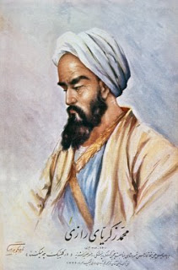
Contribution of Muslims in the development of science:
MOHAMMAD IBN ZAKARIYA AL-RAZI:
Abu Bakr Mohammad Ibn Zakariya al-Razi born on 28 August and died on 6 October .
Razi achieved mastery in a number of fields, he learnt medicine, mathematics, astronomy, chemistry and philosophy.
In-charge of the first Royal Hospital at Ray, where he remained the head of its famous Muqtadari Hospital for along time.
The practical experience gained at the well-known Muqtadari Hospital helped him in his chosen profession of medicine.
At an early age he gained eminence as an expert in medicine and alchemy.

Slide 33
Some of his written works in medicine have been widely studied.
He was the first who introduce idea of the First Aid.
To balance the weight of the medicine, he also proposed the hydrostatic balance.
Also clearly investigate depth about measles, and the understanding that smallpox occurs only once in a person's life.

Slide 34
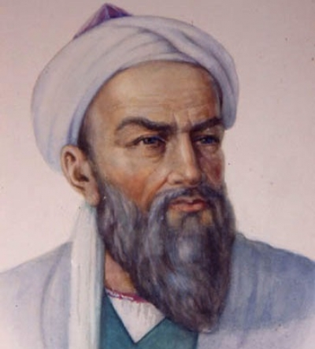
ABU RAIHAN AL BERUNI:
Abū Rayḥān Muḥammad ibn Aḥmad Bīrūnī often known as Al beruni, , (born 9 September 973 , died 13 December 1048 was a Persian scholar and polymath of the 11th century.[1][2]
Books on astronomy, astrolabes, astrology, chronology, time measurement, geography, geodesy and mapping theory, mathematics arithmetic, geometry, trigonometry), mechanics, medicine and pharmacology, meteorology, mineralogy and gems, history, India, religion and philosophy, literary works.
His one of the famous book is Qanoon Al Masoodi was translated into many languages.
He introduced the Circumference, diameter and the radius and also introduced the formation of axis.

Slide 35
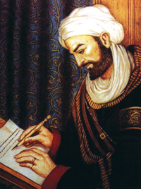
IBN SINA:
Ibn Sina (Avicenna), was a poet, music theorist, astronomer, and politician, but he was best known as a philosopher and as a medical doctor.
At the age of ten, he had completed the study of language and literature and memorized the Quran. He studied Greek logic and mathematics , However, he soon felt that his education and skills exceeded his teacher’s and he no longer needed him.
By the age of sixteen, he had covered the various sciences and became a teacher and pioneer of medicine. Because of his fame as a doctor, he was called upon to treat the prince Nuh Ibn Mansur, who then gave him access to the princely library, which was rich in rare books. By eighteen, he was confident that he had mastered the sciences except for metaphysics.
His most famous book was kitaab al qanoon, and other books was also introduced in many languages. He spent his last years writing and practicing medicine, but owing to constant travel, insufficient sleep, and hard work, he fell sick and died. He was buried in Hamadhan.
Ibn Sina was an intellectual giant whose philosophy combined Greek and Islamic thought but was unique in many respects. His ideas left a strong impact on future Eastern and Western thought.

Slide 36
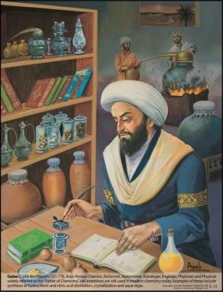
ABU MUSA JABIR IBN HAYYAN:
ABū Mūsā Jābir ibn Ḥayyān, ( born 721 and died 815)
Known as the father of chemistry, he systematized the quantitative analysis of substance.
He was the student of Imam Jafar Sadiq(a.s)
"The first essential in chemistry is that perform practical work and conduct experiments, for he who performs not practical work nor makes experiments will never attain to the least degree of mastery."
He is credited with the use of over twenty types of now-basic chemical laboratory equipment, such as the alembic and retort, and with the description of many now-commonplace chemical processes – such as crystallization, various forms of alchemical "distillation", and substances citric acid, acetic acid and tartaric acid arsenic, antimony and bismuth, sulfur, and mercury that have become the foundation of today's chemistry.
Jabir applied his chemical knowledge to the improvement of many manufacturing processes, such as making steel and other metals, preventing rust, engraving gold, dyeing and waterproofing cloth, tanning leather, and the chemical analysis of pigments and other substances. He noted the use of manganese dioxide in glassmaking, to counteract the green tinge produced by iron — a process that is still used today. Invented a kind of paper that resisted fire, and an ink that could be read at night. He invented an additive which, when applied to an iron surface, inhibited rust and when applied to a textile, would make it water repellent.“
He wrote more than 200 books
After their incredible inventions, most of his books was translated into many European languages.

Slide 37
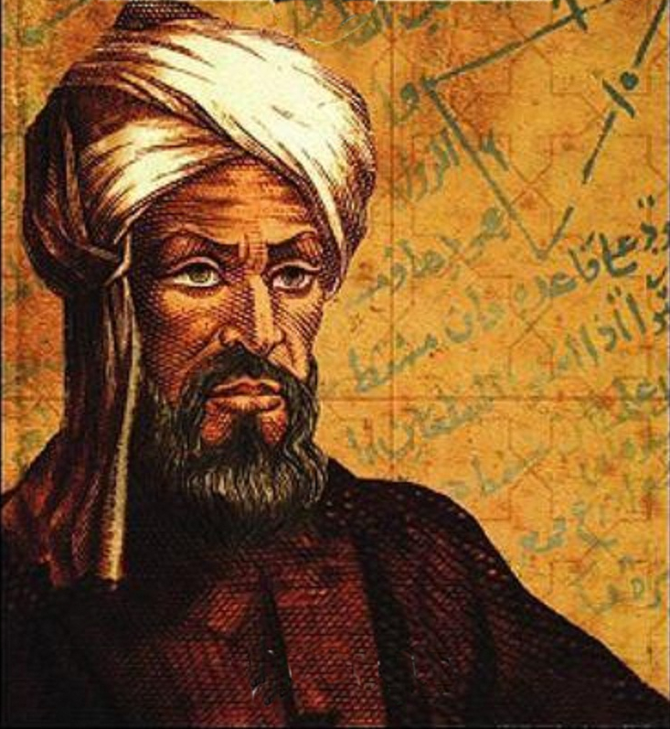
MUHAMMAD IBN MUSA AL KHAWARIZMI:
Muḥammad ibn Mūsā al-Khwārizmī(born c. 780—died c. 850)
Muslim mathematician and astronomer whose major works introduced Hindu-Arabic numerals and the concepts of algebra into European mathematics.
Latinized versions of his name and of his most famous book title live on in the terms algorithm and algebra.
His famous book was al jabar wal muqabla.
After published this book, Europeans were amazed and they also get many benefit from that book.

Slide 38
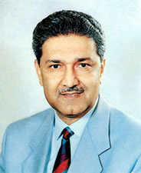
And if they were not acquire knowledge from that book, they will not succeed as they are now.
DR.ABDUL QADEER KHAN:
As a National Hero and Father of Pakistan’s nuclear bomb.
He was born on April 27, 1936 at Bhopal in central India.
He obtained the degree of Master of Science (Technology) in 1967 from Delft University of Technology, Belgium and then earned a doctorate in metallurgy in 1972. and invent an excellent bomb fuel.
When Dr. A.Q. Khan joined, it was called Engineering Research Laboratories (ERL). Later on called as Khan Research Laboratories (KRL). On May 28, 1998, Pakistan successfully tested its first nuclear device and emerged as the only Muslim country to join the nuclear club.
The scientific contributions of Dr. A. Q. Khan have been recognized in several ways. As an active scientist and technologist, he has published more than 188 scientific research papers in international journals
Khan received honorary degrees of Doctor of Science from the University of Karachi in 1993.
For his contribution, Khan was awarded Nishan-i-Imtiaz in 1996. Thus he is the only Pakistani to have received twice the highest civil award. He is also a recipient of Hilal-i-Imtiaz .

Slide 39
Thank You!!

